Slide 1
Week 2 Update (R1)
22 January 2021
Notes:
TODO: Send Justin model + tables w/ ref frame

Slide 2
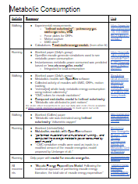
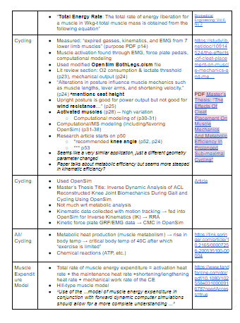
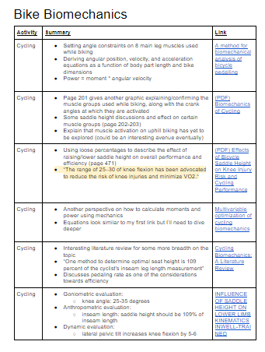
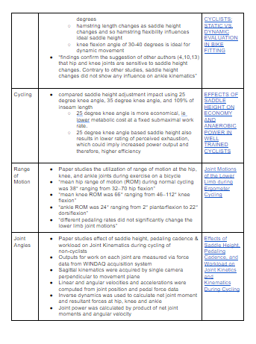
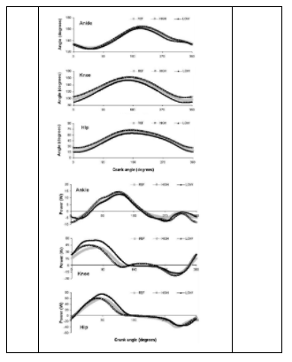
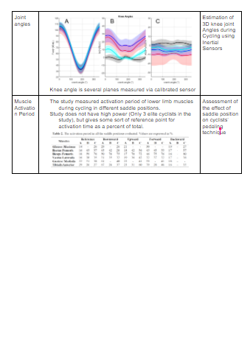
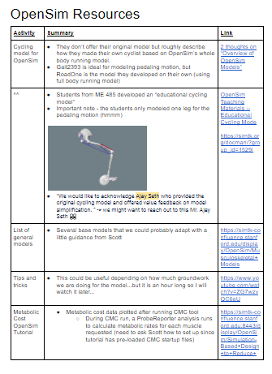
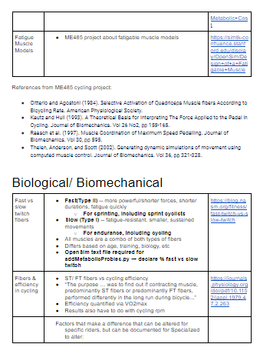
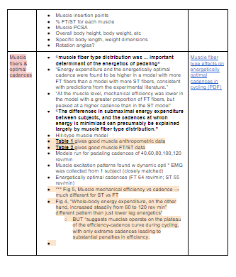
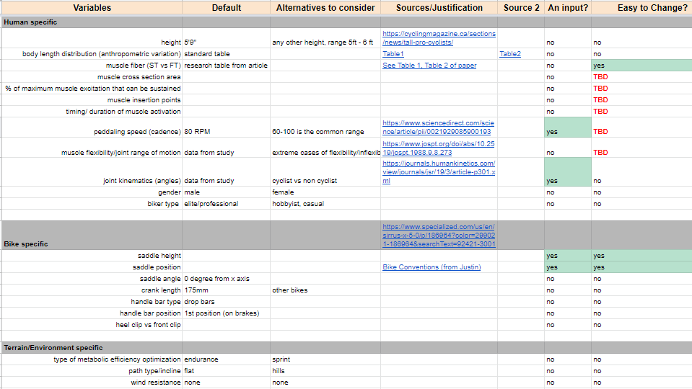
Information Gathering
Literature Review
Metabolic Consumption in movement
Bike Biomechanics
Biological/ Biomechanics
OpenSim (papers, resources)
Parameter Tracker
Consulted OpenSim experts
Scott Delp
Carmichael Ong
Ajay Seth
CEC

Slide 3
Problem Restatement
To create/propose a well-documented, proof of concept model and simulation workflow that calculates metabolic efficiency using biomechanics/OpenSim toolboxes
CEC
Notes:
From me329 website: The bicycle is the most energy efficient mode of human transportation. Even with that distinction, there is room for improvement. Significant work has been done to quantify metabolic efficiency changes resulting from relative human to bicycle fit changes. This type of testing works well for final validation but is time prohibitive to scan large design spaces or optimize across populations rather than individuals. As we search for optimal solutions it is critical to leverage simulation techniques to quickly quantify improvements for individuals and populations.
From last email: “The general idea in this study is that the fit for a rider is rotated about the BB. This keeps all of their joint angles constant but changes how their center of mass, the gravity vector, and the pedals align. See image below for how this fit rotation relates to the effective seat tube angle.”

Slide 4
Problem Constraints
OpenSim models require subject-specific motion capture (kinematics) and force capture (kinetics) for each individualized model to produce results with good fidelity
Process takes 2+ years (based on conversation with Stanford OpenSim expert)
Varying position (x,y) of saddle height requires entirely re-captured model, built from the ground up with original kinematics & kinetics in order to calculate metabolic output
In summary, OpenSim is inherently different from other simulation software (such as ANSYS) where it is simple to run a several iterations while altering a few parameters.
Optimization loops are not possible with OpenSim
CC
Notes:
From me329 website: The bicycle is the most energy efficient mode of human transportation. Even with that distinction, there is room for improvement. Significant work has been done to quantify metabolic efficiency changes resulting from relative human to bicycle fit changes. This type of testing works well for final validation but is time prohibitive to scan large design spaces or optimize across populations rather than individuals. As we search for optimal solutions it is critical to leverage simulation techniques to quickly quantify improvements for individuals and populations.
From last email: “The general idea in this study is that the fit for a rider is rotated about the BB. This keeps all of their joint angles constant but changes how their center of mass, the gravity vector, and the pedals align. See image below for how this fit rotation relates to the effective seat tube angle.”

Slide 5
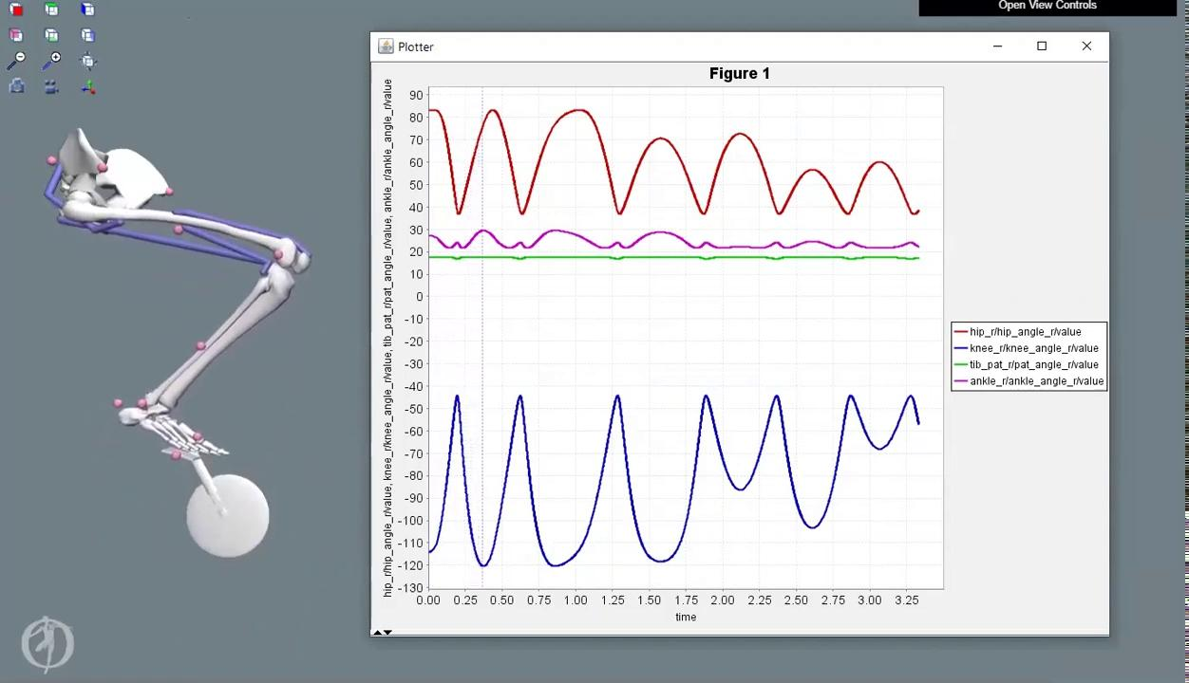
Building on previous ME 485 Model
(2018) Stanford students created this one legged simple pedaling model.
We can use this as a springboard to start developing more realistic cadence and forces
DG
Notes:
DG

Slide 6
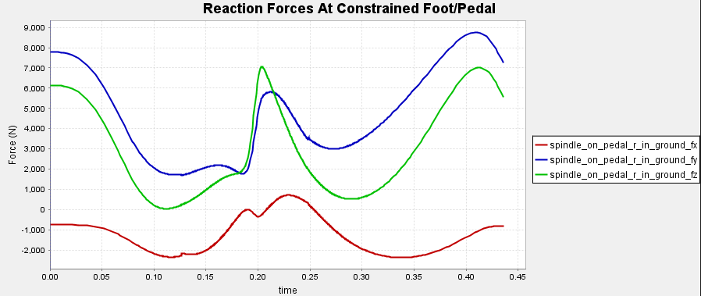
Limitations of ME 485 Model
Pedal constrained to foot → Unrealistic reaction forces
Position & dynamics inconsistent with literature
No motion capture data
No ground reaction force (GRF) at pedals
Only one set of Forward Dynamics input files
Little documentation
CEC

Slide 7
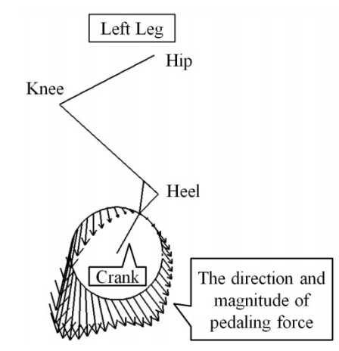
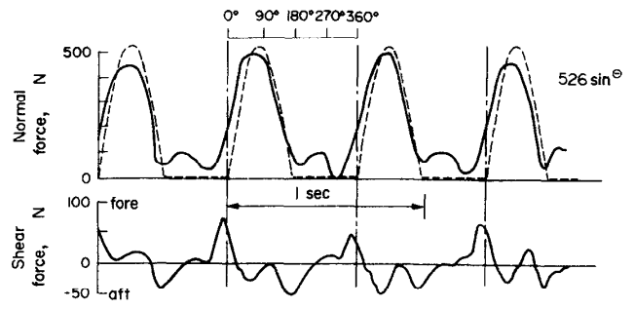
External Forces on Model
Yamashita (2013)
Assuming pelvis is constrained in X and Y at the saddle height.
The current ME 485 model has the foot physically constrained at the pedal.
We are working to develop a robust force profile at the pedal that is representative of experimental data.
SR
Soden (1979)

Slide 8
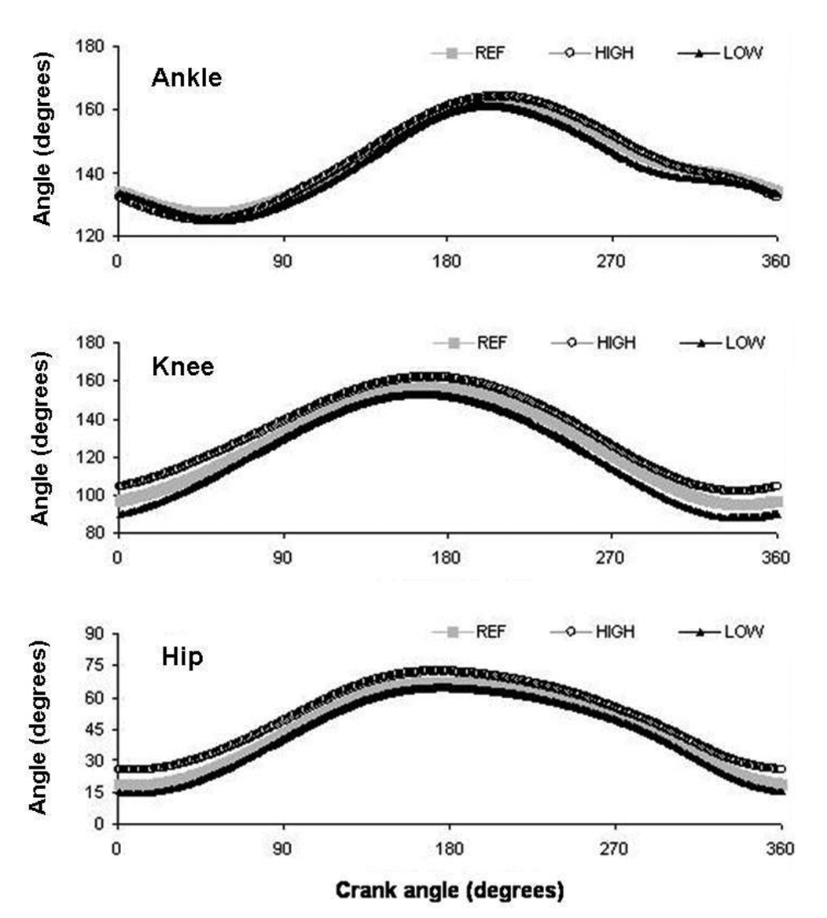
Model Joint Angles
Joint angles are traditionally measured via 3D motion capture
Joint angle data from the ME 485 model can be extracted through MATLAB (we will use data from literature to confirm accuracy)
After obtaining hip, knee, and ankle angles vs. crank angle, we can use the values in the next steps to calculate muscle forces
Bini (2010)
SR
Notes:
*Need to double check reference points / conventions on how joint angles are measured in OpenSim vs how they are measured in referenced literature

Slide 9
Workflow Proposal
Basic ME 485 Model
→ Joint Angles & Ground Reaction Forces
→ Joint Moments (Forward Dynamics)
→ Metabolic cost (metabolic probes)
→ Muscle Forces (static optimization, CMC)
→ Metabolic cost (metabolic probes)
DG

Slide 10
Next Steps
Obtain realistic external forces through literature (.xml)
Obtain joint angle data (.mot / .sto) through ME 485 model, confirmed through literature
Create OpenSim specific files (actuator file (.xml), tracking tasks (.xml), load file)
Combine both sets of data into static optimization/CMC tool in OpenSim to generate muscle forces
Continue to meet with OpenSim experts
CC

Slide 11
Timeline
Week 2 | Week 3 | Week 4 | Week 5 | Week 6 | Week 7 | Week 8 | Week 9 | Week 10
1/22 | 1/29 | 2/5 | 2/12 | 2/19 | 2/26 | 3/5 | 3/12 | 3/19
External forces |  |  | Compute muscle forces through CMC
Joint angles
Create OpenSim files
Meet with OpenSim Experts
CC

Slide 12
Questions/Asks
Does Specialized have any pedal force data/force profile over crank angle?
all
Notes:
Spring gauge on a crank - power crank
Professional versions output 200Hz
Literature is probably a better source than Specialized

